Slide 1

Mathematics for Programming

Slide 2
What is this course?
Some basic math and logic
But why?
To “talk” to the Computers
Computer can understand “programs”
Writing programs requires some logic and reasoning
Good background in basic math will help
How?
Concept
Examples
Practice, practice and practice!

Slide 3

Faculty
Past:
B.Sc. in Computer Science and Engineering (BUET)
Lecturer, United International University (UIU)
Current:
PhD in Computer Science
National University of Singapore (NUS)

Slide 4
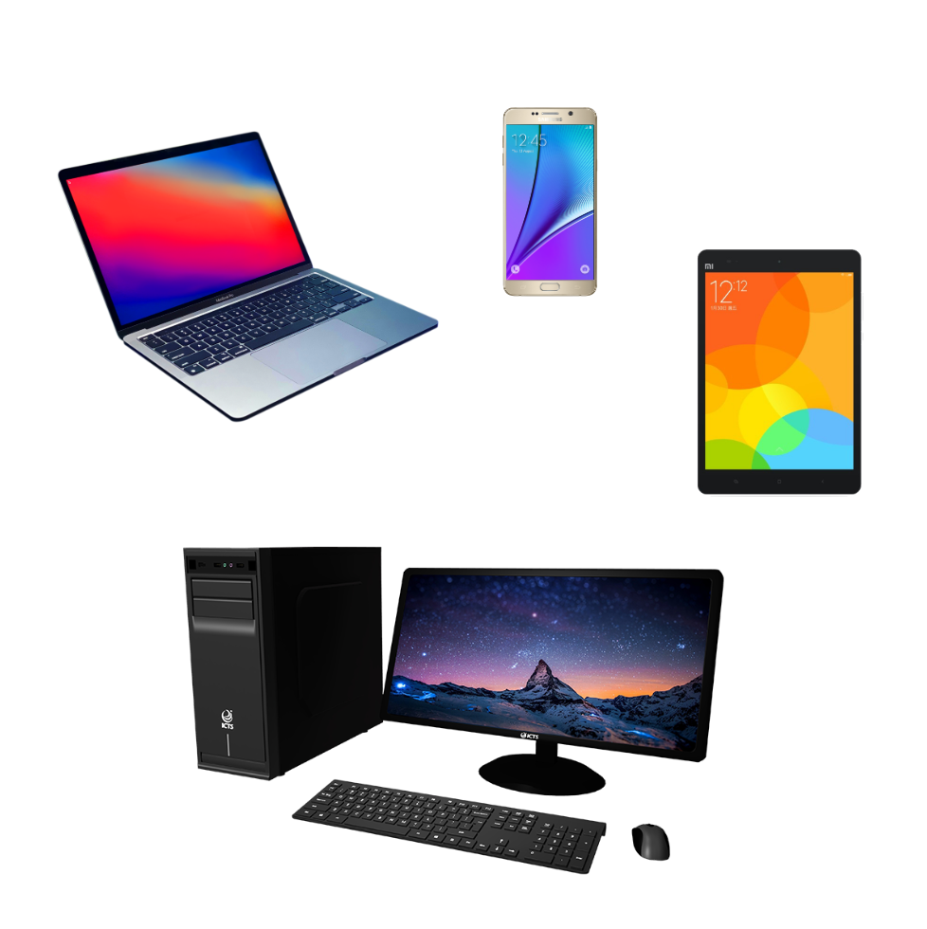
What is a computer?
A machine that computes something
Tasks:
Accept data/input
Process data
Produce output/result
Store result
Usage:
Writing documents
Browse the internet
Send emails
Play games
And many more …!

Slide 5
Components of a computer

Slide 6
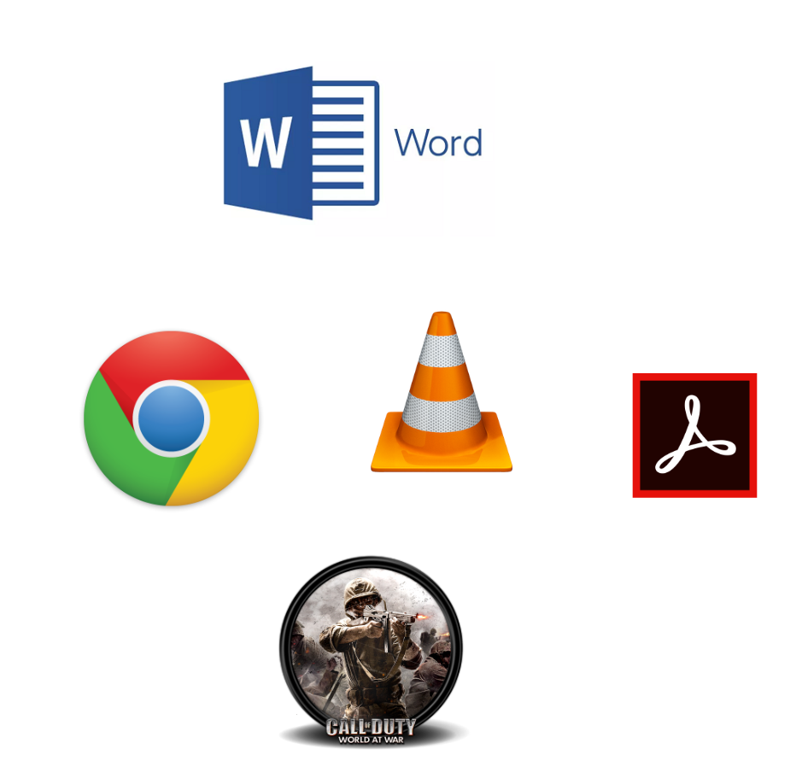
What is software?
Computer programs
Set of instructions … in a way that the machine understands!!!
Associated data
Executes specific tasks

Slide 7
What is Programming?
Building software
Writing instructions for the machine (in programming languages...)
“Coding”, sounds familiar?
Telling the computer how to perform a task
How can you get into programming?
Knowing a general-purpose programming language. C, C++, Java, Python etc.
Basic mathematics and logic
To solve a problem and to design the solution before writing code

Slide 8
How much math should I know?
Short answer: Not much!
School level mathematics are more than enough for a top programmer
+, – , / , x
% (mod), even-odd
Percentage
Coordinate system
Basic geometry
Number systems
But you must “understand” the concepts properly

Slide 9
How much math should I know?
Long answer: It depends on what you are going to do in future!
Game development
3D games and 3D graphics
Trigonometry, Linear Algebra, Matrices
Cryptography
Number theory
Machine Learning
Linear algebra, Calculus
Probability, Statistics
…
How about libraries and black-boxes?

Slide 10

Let’s begin with… number systems
Count from 0 to 12
Easy, right?
$$1 →2 →3→4→5→6→7→8→9→10→11→12$$

Slide 11

How about this?
$000$
$001$
$002$
$003$
$004$
$005$
$006$
$007$
$008$
$009$
$010$
$011$
$012$
$$0, 1, 2, 3, 4, 5, 6, 7, 8, 9 →10 digits →Decimal number system$$

Slide 12

How about 2 digits?
$000$
$001$
$010$
$011$
$100$
$101$
$110$
$111$
$…$
$$0, 1→2 digits →Binary number system$$

Slide 13
Summary
Goal of the course
Computer, software and programming
Relevance of mathematical knowledge in programming
Number system introduction

